Slide 2
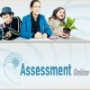
Background
Presentation is based on A Practical Guide to Assessment and Reporting, a new section on Assessment Online commissioned by The Ministry of Education. They had received feedback indicating that many schools were uncertain about what assessment and reporting might look like in the post National Standards era.
The brief was to produce advice and guidance for schools to support them with their assessment and reporting systems.
It’s important to note that this advice and guidance is an interim measure as the Ministry works with the Minister to clarify its approach to assessment and reporting during 2018.

Slide 3
http://assessment.tki.org.nz/Assessment-and-reporting-guide

Slide 4
What we were asked to do
The assignment was to advise on, and provide a range of examples of, assessment and reporting for:
literacy and mathematics
the other curriculum areas
with regard to the description in the NAGs
“a range of evidence to evaluate the progress and achievement of students and build a comprehensive picture of student learning across the curriculum”.
and
“giving priority to student progress and achievement in literacy and numeracy and/or te reo matatini and pāngarau, especially in years 1–8”.

Slide 5
Process
The broad learning objectives in the curriculum allow for, and in fact demand, interpretation for individual settings and contexts.
Schools have the discretion to design both their approach to the curriculum and to assessing and reporting on student progress and achievement, so that they recognise the aspirations and desires of the local community.
With that in mind, the guide had to be broad enough to encompass local objectives and specific enough to stimulate ideas and possible pathways to follow.
The guide has four sections.

Slide 6
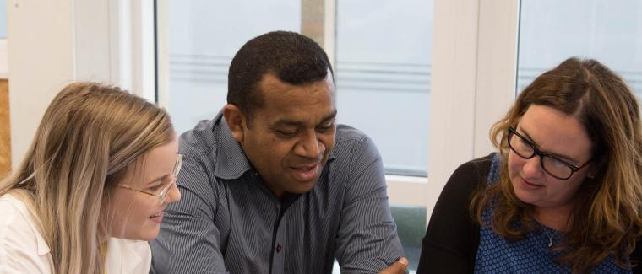
Section 1 Reviewing your school’s assessment systems
clarification of the new requirements from the NAGs
a three-step guide for schools and Kāhui Ako to help them review their current assessment systems
key principles and ideas for guidance in the process
http://assessment.tki.org.nz/Assessment-and-reporting-guide/Reviewing-your-school-s-assessment-systems

Slide 7
Opportunities
Flexibility
Room for interpretation
Recognition of needs of local community
Good time to review what works
Notes:
Flexibility about how schools assess, what assessment information they collect and analyse, and how they use it.
Room for interpretation of “assessing and reporting across the National Curriculum“. Discretion to design the approach to the curriculum and to assessing and reporting to recognise the aspirations and desires of the local community.
It’s a good time to review what works and what doesn’t and what needs to be revised, although always based on the NZC and the requirements of the NAGs.

Slide 8
From ERO report: A decade of assessment in New Zealand Primary Schools - Practice and trends - May 2018
“It is now timely to consider extending assessment practices, to determine how well students are progressing in applying their skills to meaningful tasks from other curriculum areas and key competencies.”
“As a system we need urgent agreement in respect to how we will measure, monitor and report on student progress across the Curriculum.”

Slide 9
Possible pitfalls?
Putting assessment on the back burner “now National Standards have gone”
Reverting to using only standardised test scores to determine progress and achievement
Being so inventive with interpretation of the local curriculum that the core curriculum is forgotten
Reworking progressions and in doing so losing sight of national benchmarks
Making the curriculum so wide that teachers are skimming over the surface
Forgetting about the many users of assessment data
Notes:
Others?

Slide 10
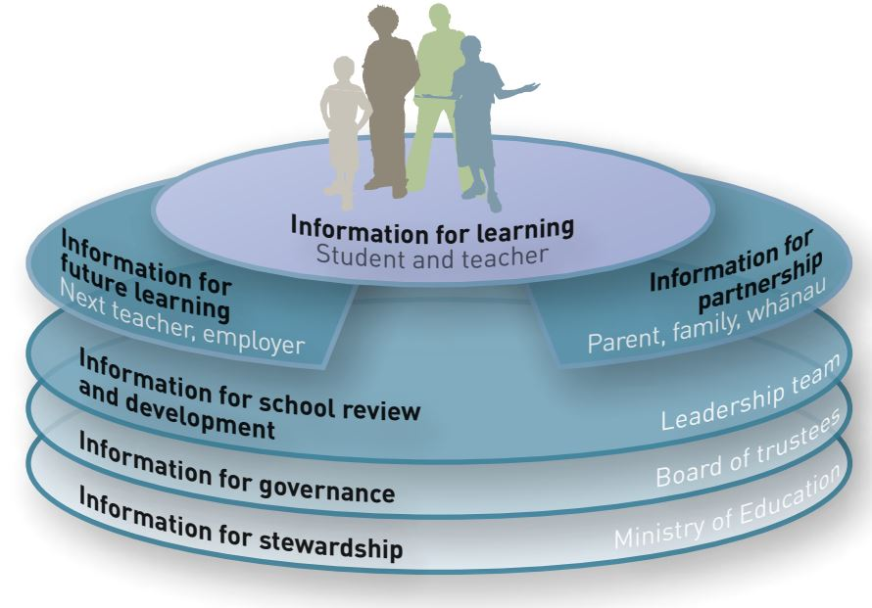
Who needs assessment data? And for what purposes?
Students
Teachers
Parents and whānau
School leaders
Boards of Trustees
Ministry of Education
How can schools collect assessment data that fills all these purposes?
Notes:
Students – are students assessment literate? Do they know where they are in their learning and what they need to learn next? Can they self assess? Do they have exemplars of what good learning looks like? Do older students have an overview/big picture of their learning?
Teachers – are teachers assessment literate? Do they know what adequate progress looks like? Are they collecting reliable assessment information about their students individually and in classes? Are they using that information to improve teaching and learning? Can they identify those students who need extra support?
Parents and whānau – do teachers share progress and achievement adequately with parents and whānau? Are there good communication channels between them? Are reports clear and easily accessed and understood? Do parents and whānau know how their children are progressing and how they can support them at home?
School leaders and board of trustees – are leaders supporting teachers with: clear school schemes and curriculum planning; effective classroom assessment for learning; the collection of reliable assessment information? Can they identify those groups of students who need extra support? Are they confident that they have reliable data to plan and resource for improvement?
Ministry of Education – can the school or Kāhui Ako provide reliable information in both their charter and their analysis of variance that provides a clear picture of progress and achievement within their school, and those areas that are focused on for improvement.?

Slide 11
Review questions for schools
Literacy and mathematics
Do we want to keep assessing and reporting against National Standards?
If not, what benchmarks will we use to determine progress and achievement?
Can we provide progress and achievement information to all stakeholders?
Is there good assessment for learning practice in our classrooms?
Are the more formal assessments (for example: running records, e-asTTle tests, JAM) administered accurately and in a timely fashion?
Do we use our assessment information primarily for teaching and learning? Do teachers know how?
Have we got effective and timely storage and retrieval for assessment information?
Are we assessing too much? Or too little?

Slide 12
Review questions for schools
Other curriculum areas
Have we been neglecting these areas in favour of literacy and numeracy?
Are there areas of the curriculum that we need to boost?
Are there clear school schemes for these curriculum areas? Are there clear expectations for teachers?
How will we provide progress and achievement information to stakeholders?
Is there good assessment for learning practice in our classrooms?
Have we got effective and timely storage and retrieval for assessment information?
Are we assessing too much? Or too little?

Slide 13
Key messages
If schools choose to review their approach, it is still important to ensure that any changes retain at least the same rigour and educative purpose as before.
Keep overall judgments of progress and achievement as a central part of the system at all levels.
Don’t throw the baby out with the bath water. Keep those things in your school that are working well, and change or implement those that need to be updated.

Slide 14
Section 2 School stories – a variety of approaches to assessment
School stories were sought to illustrate a variety of approaches to teaching, assessment and information sharing.
The section includes eight (for the moment) school stories.
Of particular interest are the ways schools are working to integrate curriculum objectives with the Key Competencies and other learning prerequisites at the ‘front end’ of the curriculum.
http://assessment.tki.org.nz/Assessment-and-reporting-guide/School-stories-a-variety-of-approaches-to-assessment

Slide 15
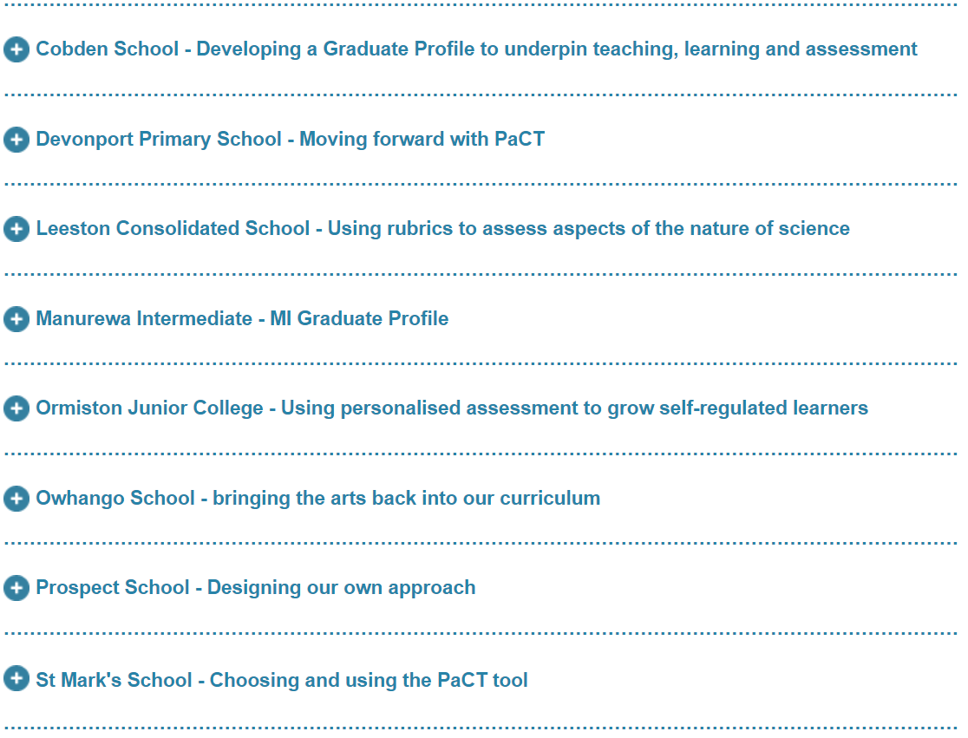

Slide 16
Key message
The key message from each of the schools is that none of these stories is of a finished and final product. Their ideas and systems are in a constant state of review and evaluation, always in the service of improved learning for their students.

Slide 17
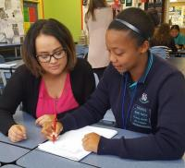
Section 3. Measuring progress across the curriculum
This section contains a compilation of the curriculum and assessment resources available to schools
from across the curriculum areas
in literacy and mathematics (foundational learning areas)
http://assessment.tki.org.nz/Assessment-and-reporting-guide/Measuring-progress-across-the-curriculum

Slide 18
Key messages
While every school curriculum must be clearly aligned with the intent of the NZC, schools have considerable flexibility when determining the detail of teaching, learning and assessment in their context.
Literacy and mathematics are fundamental as they enable learners to meet the demands, and access the breadth and richness of our NZC.
Think carefully about your purposes for assessment. Assess only when the information will be used to improve teaching and learning. Do not over assess.

Slide 19
Section 4. Making teacher judgments on progress and achievement
This section focuses on effective judgment making so that judgments are dependable and the process of making decisions is useful to teachers and student learning.
http://assessment.tki.org.nz/Assessment-and-reporting-guide/Making-teacher-judgments-on-progress-and-achievement

Slide 20
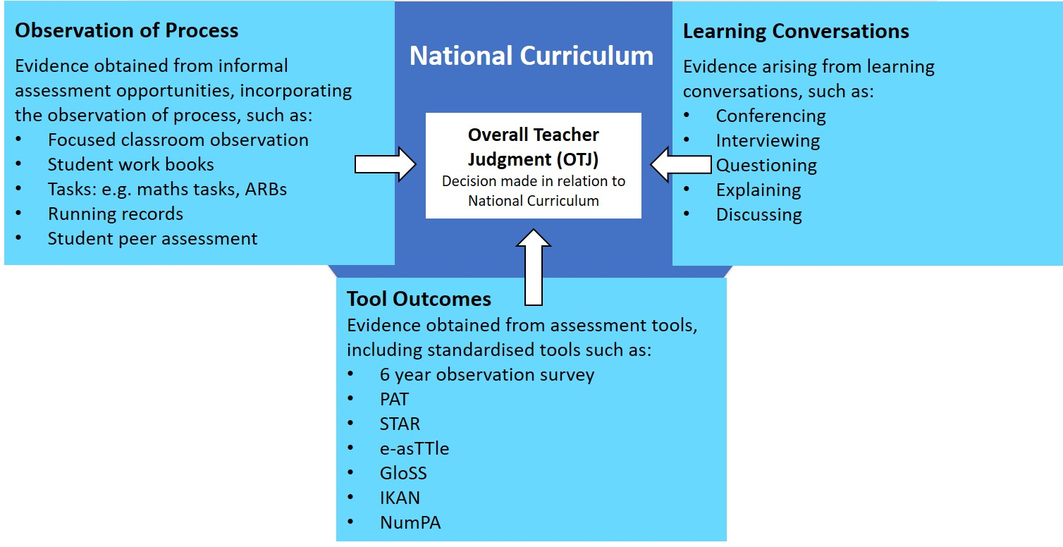
Key messages about OTJs
No single source of information can accurately summarise a student’s progress or achievement.
The use of a range of evidence builds dependability in decisions.
Students should actively participate throughout the assessment process.

Slide 21
What’s in the pipeline?
This is a time of change. What comes next is still undetermined.
The Curriculum, Progress and Achievement Ministerial Advisory Group and Reference Group will report back soon with recommendations.
The Local Curriculum Design Toolkit for Kāhui Ako is being developed and will bring together new thinking on curriculum and assessment.
The Curriculum Progress Tools (Learning Progression Frameworks and Progress and Consistency Tools) are developing and usage is growing.
There appears to be a growing emphasis on:
integration of the ‘front end’ and the ‘back end’ of the curriculum
schools creating graduate profiles, particularly around transition points i.e. end of years 3, 6, 8, 10
local curriculum
integrated cross-curricular learning
Notes:
Weaving a Coherent Curriculum – Rose Hipkins http://www.nzcer.org.nz/system/files/Weaving%20a%20coherent%20(v5).pdf
Making meaning
Perspective Taking
Critical Inquiry
Taking Action
https://www.education.govt.nz/communities-of-learning/about/cross-sector-forum-toolkit/

