Slide 1
Assessment and reporting in the era of change

Slide 2
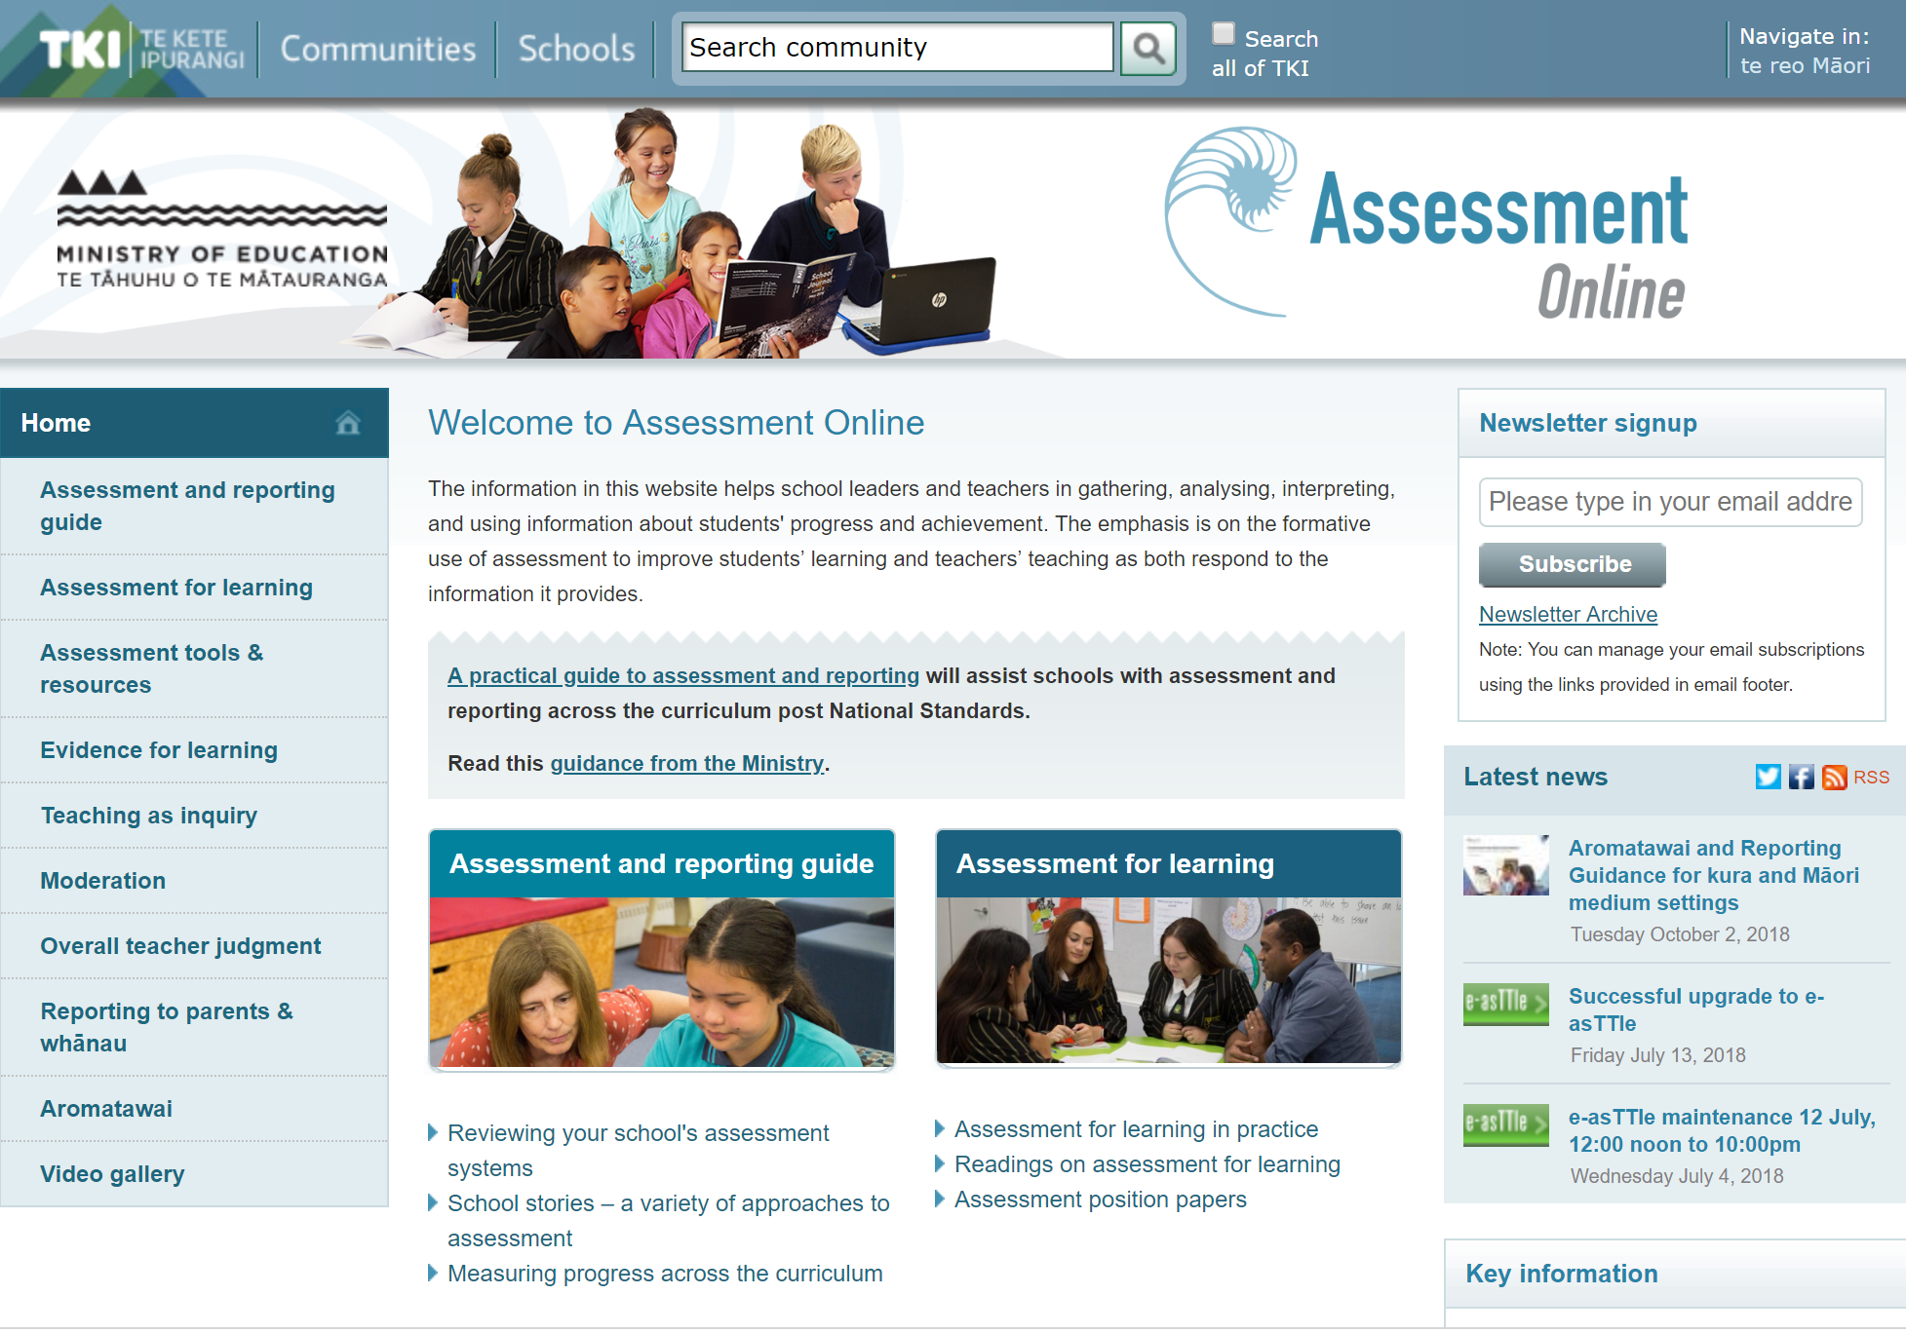
http://assessment.tki.org.nz/

Slide 3
Let’s start with this fundamental proposition:
Assessment is the bridge between teaching and learning.
The nature and purposes of assessment are described on pages 39–41 of the New Zealand Curriculum.
“The primary purpose of assessment is to improve students’ learning, as both student and teacher respond to the information that it provides.”
Notes:
Assessment does not correlate with testing. It can do, but not exclusively, and preferably not often.

Slide 4
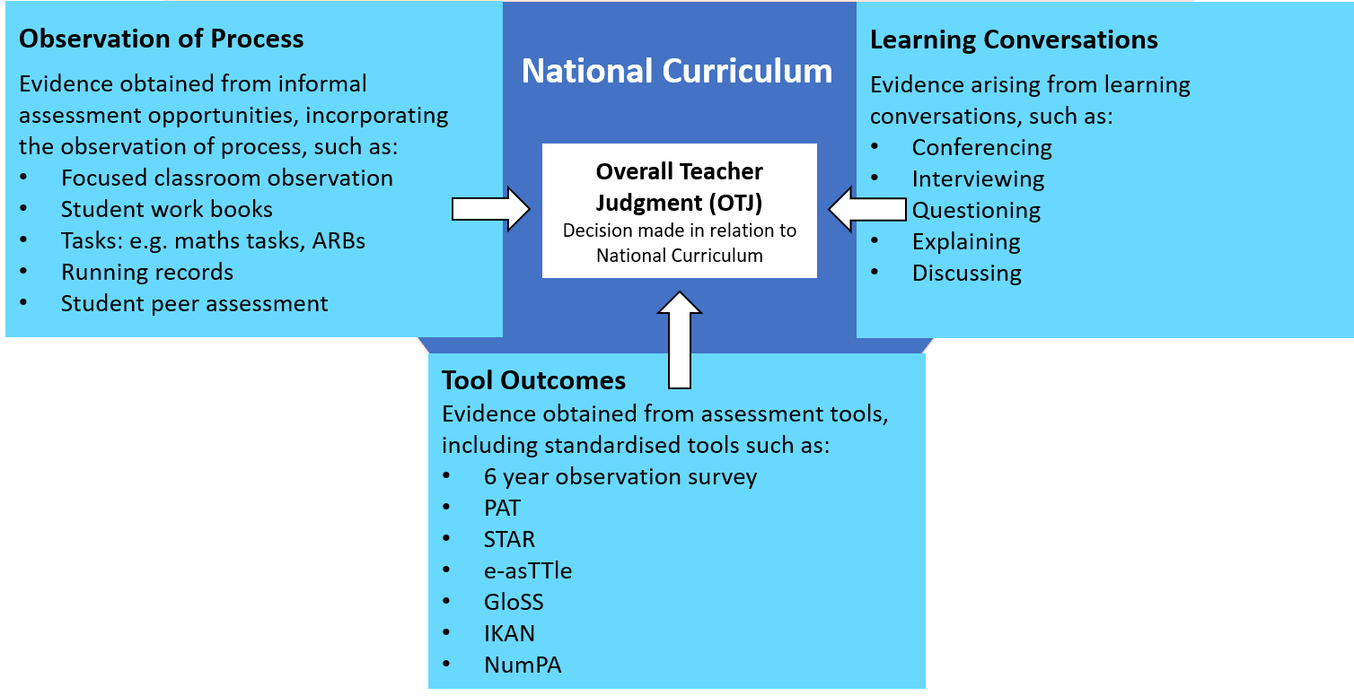
What sort of assessments are we talking about?
Notes:
Specifically aimed at primary and intermediate teachers. However, the same principles apply to years 9 and 10 in secondary school, with more formalised processes thrown in such as class tests, cohort tests, school exams. Direct teachers to the recently developed Learning Progression Frameworks http://assessment.tki.org.nz/Assessment-tools-resources/Learning-progression-frameworks

Slide 5
Assessment and reporting in a time of change
So what has changed already?
It is no longer compulsory to assess or report against National Standards.
There is a specific requirement to teach, assess and report on progress and achievement across the curriculum.
Notes:
We are living in times of changing education policy. The mandatory use of National Standards has been removed, and a review of NCEA is underway. This workshop will demonstrate how Assessment Online TKI is keeping you abreast of policy changes through the creation of resources to best support leaders, teachers and, most importantly, their learners. Of special interest are school stories about different approaches to assessment in the post National Standards era, and the reframing of reporting to parents and whānau as a collaborative information sharing opportunity.

Slide 6
What is under review?
What is under review?
Curriculum, Progress and Achievement Ministerial Advisory Group will report back soon on their findings.
NCEA review is underway and has been extended
Tomorrow’s Schools
Notes:
We are living in times of changing education policy. The mandatory use of National Standards has been removed, and a review of NCEA is underway. This workshop will demonstrate how Assessment Online TKI is keeping you abreast of policy changes through the creation of resources to best support leaders, teachers and, most importantly, their learners. Of special interest are school stories about different approaches to assessment in the post National Standards era, and the reframing of reporting to parents and whānau as a collaborative information sharing opportunity.

Slide 7
Opportunities
The broad learning objectives in the curriculum allow for, and in fact demand, interpretation for individual settings and contexts.
Schools have the discretion to design both their approach to the curriculum and to assessing and reporting on student progress and achievement, so that they recognise the aspirations and desires of the local community.
It’s a good time to review what works and what doesn’t.

Slide 8
Possible pitfalls?
Putting assessment on the back burner “now
that National Standards have gone.”
Reverting to using only standardised test scores to determine progress and achievement
Being so inventive with interpretation of the local curriculum that the core curriculum is forgotten
Reworking progressions and in doing so losing sight of national benchmarks
Making the curriculum so wide that teachers are skimming over the surface
Forgetting about the many users of assessment data
Notes:
Others?

Slide 9
What hasn’t changed?
What hasn’t changed? We still need:
assessment capable students and teachers
effective assessment practices, both informal and formal
sound overall teacher judgments on progress and achievement
clear information sharing with parents and whānau.
Notes:
We are living in times of changing education policy. The mandatory use of National Standards has been removed, and a review of NCEA is underway. This workshop will demonstrate how Assessment Online TKI is keeping you abreast of policy changes through the creation of resources to best support leaders, teachers and, most importantly, their learners. Of special interest are school stories about different approaches to assessment in the post National Standards era, and the reframing of reporting to parents and whānau as a collaborative information sharing opportunity.

Slide 10
What’s on Assessment Online that can help?
A Practical Guide to Assessment and Reporting NEW!!
Reporting to parents and whānau
Assessment for Learning - Oldie but a goodie!!
Assessment tools and resources
Gathering and using evidence for learning
Moderation and making overall teacher judgments

Slide 11
Have a play!
Make your own way around the website or use the Word document we’ve supplied, complete with some suggested activities. Take your time and ask any questions that you may have.
You can e-mail the team at Assessment Online at any time: assessment@tki.org.nz We’re always keen and ready to help. Let us know what you need!

Slide 12
Sign up for our newsletter from the Home Page http://assessment.tki.org.nz/
Join us on Facebook https://facebook.com/AssessmentTki
Follow us on Twitter https://twitter.com/AssessmentTKI

