Slide 1
Using data to transform teaching and learning
Adrienne Carlisle and
Brenda Crozier

Slide 2
Learning intention
How to use data to improve teaching and learning
Success criteria
I will have an understanding of:
What is data?
What is assessment literacy?
Which assessment tool/s to use?
Collecting, collating and displaying data
Reading and analysing data
Putting faces to the data
I will know which resources on Assessment Online will support me to work with data.

Slide 3
Types of evidence
Quantitative data
Assessment data
Attendance
Retention
Engagement
Qualitative
Classroom interactions
Demographics
Student and community perceptions
School systems and processes
http://assessment.tki.org.nz/Using-evidence-for-learning/Gathering-evidence/Topics/Types-of-evidence
Notes:
Difference between evidence and data. Which is better? Which is more important? Which is the most accurate? Which category does OTJ data come into?

Slide 4
Assessment literacy
Use of assessment information
Use of assessment tools
The "big picture" of assessment
http://assessment.tki.org.nz/Assessment-in-the-classroom/Assessment-for-learning-in-practice/Assessment-literacy#Capabilities
Notes:
Handout of capabilities. Direct participants to capability 3.

Slide 5
Starting with this proposition:
Assessment is central to teaching and learning
The nature and purposes of assessment are described on pages 39–41 of the New Zealand Curriculum.
The primary purpose of assessment is to improve students’ learning, as both student and teacher respond to the information that it provides.
Notes:
Assessment does not correlate with testing. It can do, but not exclusively, and preferably not often.

Slide 6
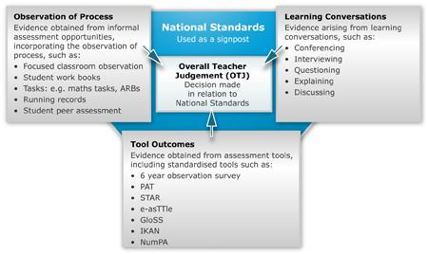
What data are we talking about?
Notes:
Specifically aimed at primary and intermediate teachers. However, the same principles apply to years 9 and 10 in secondary school, with more formalised processes thrown in such as class tests, cohort tests, school exams. Direct teachers to the recently developed Learning Progression Frameworks http://assessment.tki.org.nz/Assessment-tools-resources/Learning-progression-frameworks

Slide 7
Forms of assessment
On-going formative assessment in the classroom
Mid-range informal assessment
Formal assessment
http://assessment.tki.org.nz/Using-evidence-for-learning/Gathering-evidence/

Slide 8
On-going formative assessment in the classroom
The student needs to know:
Where am I going?
Where am I at the moment?
How can I bridge the gap?
http://assessment.tki.org.nz/Assessment-in-the-classroom/Assessment-for-learning-in-practice
Notes:
Named ‘the student’ rather than ‘students’. Learning, and its path, should be as individualised as possible.

Slide 9
Where am I going?
Learning intentions
Unit overviews
Course prescriptions
Where am I at the moment?
Ongoing teacher assessment
Self and peer assessment against success criteria
Informal and more formal testing
How can I bridge the gap?
Success criteria
Exemplars and modelling
Feedback and learning conversations

Slide 10
Formative assessment capabilities – Activity
Choose one of the capabilities.
Assess your formative assessment capability.
Set yourself a formative assessment goal for your classroom. You could base your classroom inquiry on one of the strategies.
Notes:
A3 AfL indicators. Hard copy.

Slide 11
Mid-range informal assessment
pre-testing of topics to establish learning needs
mid- or post-testing of topics to assess value-added and ongoing learning needs
running records
informal quizzes
teacher/student developed rubrics
measurement against progressions of learning
relevant items from the Assessment Resource Bank
questions from previous NCEA papers
Notes:
What’s the purpose of this sort of assessment? How does it work best? What sort of data does it produce? Does it need to be recorded? Who needs to know?

Slide 12
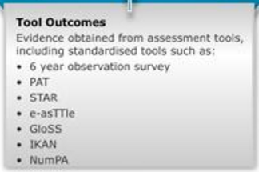
Formal assessment
Tool outcomes
Evidence obtained from assessment tools including standardised tools such as:
6 year observation survey
PAT
STAR
e-asTTle
GloSS
IKAN
NumPA
Notes:
Why use a tool? What are the advantages? Correlation between tool data and OTJ? Talk about PaCT.

Slide 13
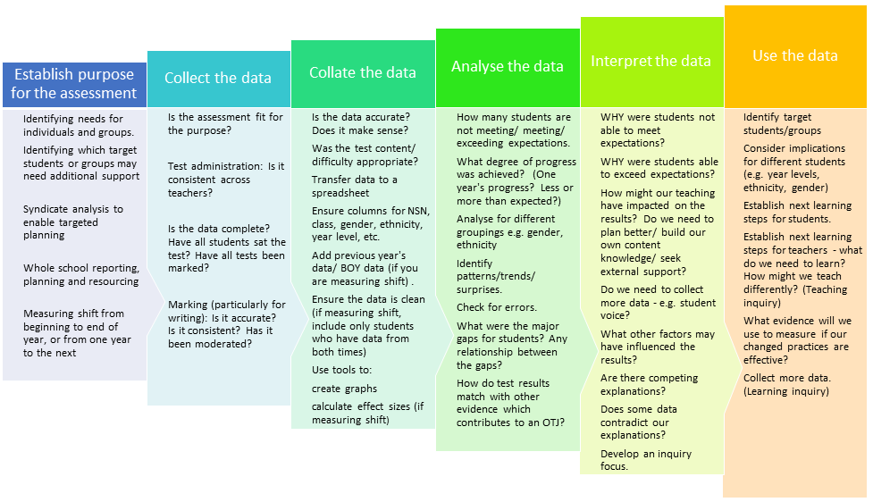
Assessment and data analysis - a process
Notes:
Hand out hard copy. Also put in resources.

Slide 14
Which tool/s to choose
There is a large range of assessment tools available for teachers. How to decide which is best for your purposes?
You can go straight to the assessment tool selector here:
http://assessment.tki.org.nz/Assessment-tools-resources/Assessment-tool-selector
Or you can find a tutorial on using it here:
http://assessment.tki.org.nz/Using-evidence-for-learning/Gathering-evidence/Topics/Assessment-selection

Slide 15
Which tool/s to choose – Activity
Find assessment tool/s within these parameters:
Reading
Year 6
Standardised
NZ developed
http://assessment.tki.org.nz/Assessment-tools-resources/Assessment-tool-selector
Compare three of them.
Notes:
Five minutes. There will be more time at the end to have a play.

Slide 16
Assessment and data analysis - a process
Notes:
Hand out hard copy. Also put in resources.

Slide 17
Collecting the data
Are your school processes standardised?
Have all students been included?
Is the marking accurate?
Is the data entry (if it’s needed) accurate?
Notes:
Rubbish in, rubbish out

Slide 18
Putting your data onto a spreadsheet
Often, data from assessment tools (e.g. e-asTTle) comes in a CSV format which can be converted to an Excel spreadsheet
Data can be downloaded from Student Management Systems as a CSV file.
Data can be entered manually onto a spreadsheet.
http://assessment.tki.org.nz/Using-evidence-for-learning/Working-with-data/Topics/Downloading-data
Notes:
Watch the tutorial if you need to about putting together a spreadsheet.

Slide 19
Collating the data – first things first
Ensure the accuracy of the data!
There is no point going further with collation or analysis until this is done.
What problems might you be looking for?
http://assessment.tki.org.nz/Using-evidence-for-learning/Working-with-data/Topics/Cleaning-and-formatting-data
Notes:
Check the Assessment and Data Analysis sheet!
Gaps in the data. Missing demographic information. Figures that are self evidently wrong. Use your common sense!

Slide 20
Cleaning and formatting data
Data records should be:
Consistent
Accurate
Complete
http://assessment.tki.org.nz/Using-evidence-for-learning/Working-with-data/Topics/Cleaning-and-formatting-data

Slide 21
Creating your own graphs
You can create graphs in Excel from your data.
Take a look at the video tutorial:
http://assessment.tki.org.nz/Using-evidence-for-learning/Working-with-data/Topics/Creating-your-own-simple-graphs

Slide 22
Disaggregating the data
You can then analyse the data in different ways:
By year level
By gender
By ethnicity
By class
http://assessment.tki.org.nz/Using-evidence-for-learning/Working-with-data/Topics/Disaggregating-data
Watch the video demonstration on pivot tables.

Slide 23
Disaggregating data – Activity
Use the data sheet at the bottom of the page shown below to do the following:
Use the combined data set to do the following:
Create a pivot chart to compare beginning and end of year results by ethnicity
Create a pivot chart to compare beginning and end of year results by gender
http://assessment.tki.org.nz/Using-evidence-for-learning/Working-with-data/Topics/Disaggregating-data
Notes:
Add data sheet to Assessment Online!!

Slide 24
Assessment and data analysis - a process
Notes:
Hand out hard copy. Also put in resources.

Slide 25
Reading and analysing data
Creating or accessing data reports
Reading and understanding graphs or data reports
Asking questions
Digging deeper
Developing an inquiry focus
http://assessment.tki.org.nz/Using-evidence-for-learning/Reading-and-analysing-data
http://assessment.tki.org.nz/Assessment-in-the-classroom/Assessment-for-learning-in-practice/Assessment-literacy#Resources
Notes:
Use the information you’ve got. e-asTTle and PAT and Star provide data reports. Learn to read them. They provide good advice on what students are good at and what they’re not so good at. Delve into the data. It doesn’t have to be technological - what about a simple table with student results written in? Don’t be frightened!

Slide 26
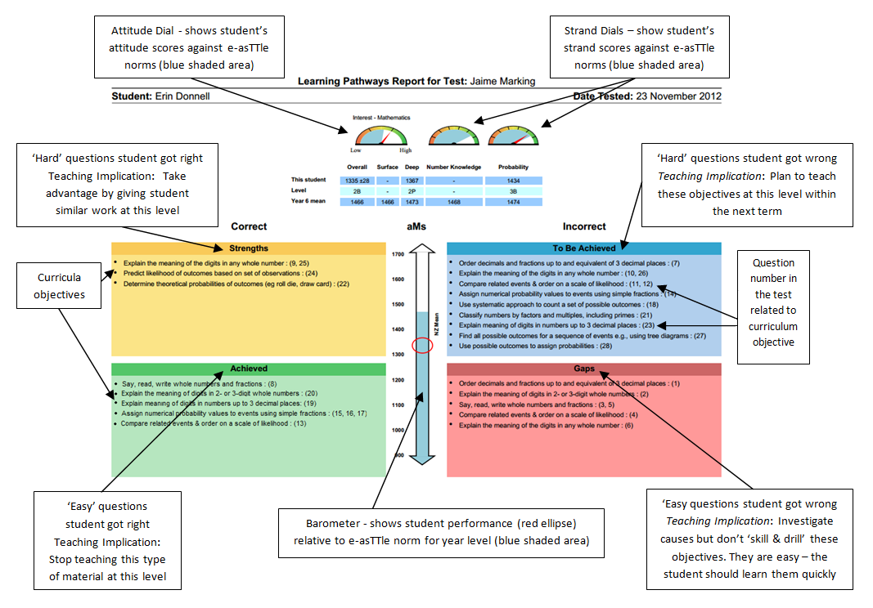

Slide 28
How are your students involved in assessment?
Students need to be skilled assessors of their own learning and be able to use or participate in a range of assessment approaches suited to subject, context and purpose.
If you are enabling your students to maintain their agency in assessment, your students should be able to give good answers to the questions on the assessment sheet. Could they?
http://assessment.tki.org.nz/Assessment-in-the-classroom/Assessment-for-learning-in-practice/Assessment-literacy#Resources
Notes:
Handout - What students need to know about assessment

Slide 29
Have a play!
Take some time to find your way around the resources on Assessment Online. We can help you with using data to support teaching and learning.
You can e-mail the team at Assessment Online: assessment@tki.org.nz

