Slide 1
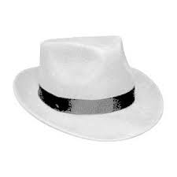
What are you learning?
WALHT We are learning how to…
Why are you learning this?
CLARITY We are learning this because…
How are you going to achieve this learning?
SUCCESS CRITERIA I can check my steps to achieve this learning…
Start your task. Once it is completed…
REFLECT
What did you do well in your learning?
I believe that this went well because…
What do you think you need to work on?
I think that I need to work on…
What do I need to do NOW to improve my learning?

