Slide 1
Supporting Teachers to make Overall Teacher Judgments
The Consortium for Professional Learning

Slide 2
The Purpose of OTJ workshops
Moderation - To deepen the quality of professional talk in order to establish shared understandings and improve teaching and learning.
To apply evidence based decision making to build
the consistency and validity of teacher judgments.
The aspect framework will provide the context for achieving this purpose.
Participants will have support materials to assist leading professional talk and decision making about how to consider and respond to student learning.

Slide 3
Workshop process
Review the current context in relation to National Standards
Use the Aspect Frameworks and their illustrations
Make an evidence-based judgment using the frameworks
Engage in professional discussion about judgments (moderation process)
Discuss key considerations when moderating

Slide 4
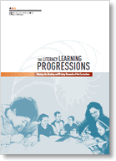
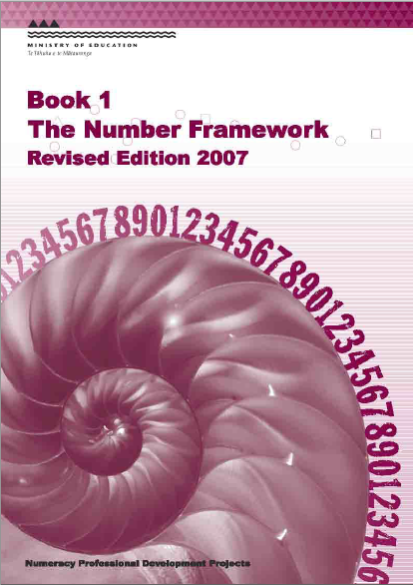
2010
The New Zealand Curriculum
Literacy Learning Progressions & The Number Framework
The National Standards

Slide 5
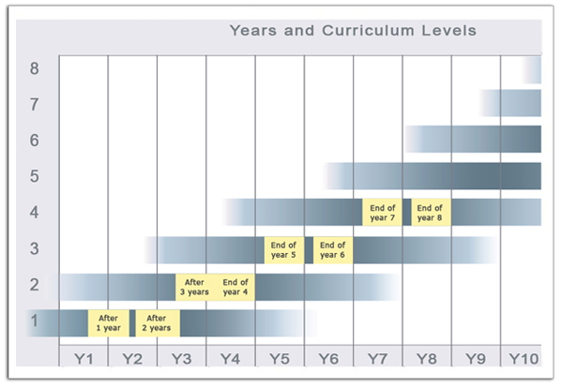
Current context
Curriculum = outcomes
Progression documents = indicators
Standards = signposts for progress

Slide 6
Current context
OTJs are made using multiple sources of evidence
Evidence is collected in a variety of ways -learning conversations, observations and assessment tools
OTJs are made using evidence that show application of the skills, knowledge and understandings across the curriculum
Consistency is essential to the dependability of OTJs – moderation is the process.

Slide 7
Monitoring and Evaluation Project
Evidence suggests that OTJs do not yet have dependability.
This does not mean that all OTJs are inaccurate.
The inconsistency in teachers’ ratings is likely a result of the relatively broad nature of the National Standards scale.
The report indicates principals and teachers perceive a need for further support around OTJs.
Reference 2013

Slide 8
Monitoring and Evaluation Project
Moderation – more common in the area of writing than reading or maths.
There has been an increase in the
understanding of moderation as an ‘evaluation discussion informed by evidence of student achievement.’
No. of schools moderating effectively has increased
Reference 2013

Slide 9
How does your process sit against the picture we have presented
– 2 minutes

Slide 10
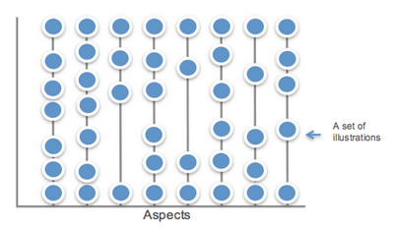
The New Zealand Curriculum
Literacy Learning Progressions & The Number Framework
The National Standards
The Aspect Framework

Slide 11
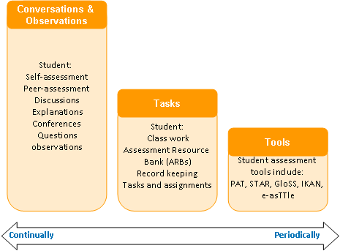

Slide 12
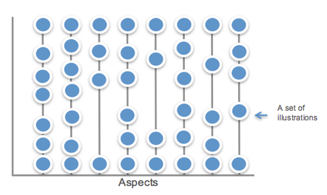
Aspect Framework

Slide 13
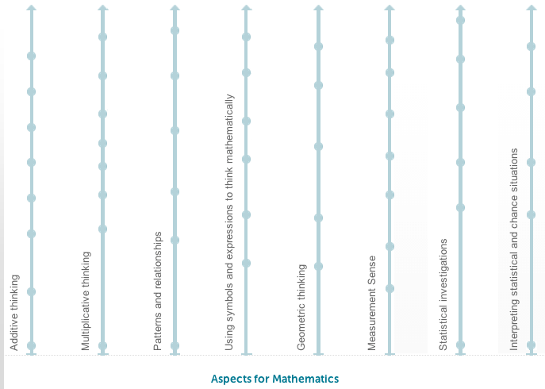
Maths framework

Slide 14
The Aspect Framework – Reading and Writing
The standards for reading and writing are constructed differently from the way the mathematics standards are. This is because they are cross-curricular competencies.
The standards for reading and writing are established by the level of literacy expertise that students need if they are to meet the reading and writing demands in all curriculum areas.
Therefore, the aspects reflect this by deliberately using illustrations from different learning areas. For example, a science report or a technology text.

Slide 15
Illustrations
What are the common components?
What is the importance of each part?

Slide 16
The components of an illustration
A unique title.
An annotation that highlights the key features of the student response.
The problem (for mathematics) or the text and task (reading and writing), which are the focus of the illustration. This also includes the conditions under which the task was completed, for example, independently or with support.
The student response details how and what the student did in response to the problem or task. The response may include a work sample and or a transcript of a discussion with a teacher.

Slide 17
Sets of Illustrations
The observable steps of learning in each aspect are described through sets of illustrations.
Each set has been developed to illustrate a big or important idea in the aspect progression.
Each set describes the important features that teachers should notice and recognise about what each student knows and can do.

Slide 18
Activity 2
Order these illustrations to show the progression through the learning steps.
1st - Additive Thinking (white paper)
2nd - Measurement Sense (yellow paper)

Slide 19
Activity 2 answers – Additive thinking
Dice
Tens frames
Bears in the cave
Trusting the count
Rotten plums
Getting off the bus
The meeting
Bags of wheat

Slide 20
Activity 2 answers – Measurement Sense
Comparing two objects by weight
Comparing coloured strips
Coloured strips
Matchstick rulers
Make a shake
New carpet for the library
Complex area

Slide 21
How does an activity such as this build consistency?

Slide 22
Illustrations
The illustrations are NOT assessment tasks to see if students can do them.
They should prompt questions such as:
What evidence do I have?
Is this the type of level that ______ could demonstrate?
Is this the ‘kind of way’ that ______ would solve these problems?
Is this the ‘kind of way’ that ______ would write ideas, experiences or information
Is this the ‘kind of way’ ______ would respond to a text

Slide 23
Activity 3
Purpose:
Use the aspect framework to guide judgment making
To use professional talk as a form of moderation

Slide 24
Setting the scene
Judgments should be made as a result of noticing and recognising student learning in the course of a normal classroom programme.
To provide a succinct collation of student thinking we have used a one on one interview for this workshop.
Learning context – the supermarket.

Slide 25
Ben
In pairs use the video evidence and teacher description to make a judgment in relation to the following two aspects:
Additive thinking
Measurement sense
Use the concept of ‘best fit’
Use the illustrations – confirm with descriptions

Slide 26
Moderation is the process of sharing expectations and understanding of standards in order to improve the consistency of decisions (reaching agreement).
(TKI Assessment)
Professional talk:
Planned
Informal

Slide 27
Principles of moderation
Evidence-based discussions
Tolerance of different views
Openness - viewing differences as an opportunity to learn
Willingness to adapt thinking
Use agreed reference materials
Accurate judgments will better support student learning
Multiple sources of evidence is required

Slide 28
Moderate your decision
Where did you place your judgment and why?
Is there consensus?
How does your evidence relate to the set of illustrations?
What do others think and why?(even if you all scored the same)
Have we reached consensus on ‘best fit’?

Slide 29
Using the framework to support moderation
Moderate what?
areas teachers are finding difficult
sample selection of students.
Students for whom making aspect decisions was difficult (gaps in evidence or where ‘best fit’ was difficult)

Slide 30
Planning for moderation
When/who/how:
When does moderation need to take place?
Who is involved?
Within school / across schools?

Slide 31
The value of the framework
Builds consistency of what to notice and recognize
Highlights gaps in learning opportunities
Gives a consistent framework within and across schools
Progress through learning steps is made visible

Slide 32
Ben’s recommended OTJ
Recommended
OTJ
= End of Year 5
5
6
4
5
3
3
3
3

Slide 33
Role of standardised tools
Standardised test information is still an important form of evidence
For example, correlation between standardised tool and OTJ can provide a degree of confidence.
Non-correlation does not mean the recommended OTJ is incorrect.

Slide 34
Links
The Aspects Framework
The Mathematics aspects
Overall Teacher Judgements
Moderation
The National Standards School Sample Monitoring and Evaluation (NSSSME) Project
Support material from this workshop will be available on the CPL website .

Slide 35
Reflect and evaluate
In what ways will this workshop impact on your moderation practice in your school?
What are the next steps for Teaching and Learning in your school?

