Slide 1
Reviewing and refining your moderation processes and systems
Module Four: Moderation Series for Primary Teachers

Slide 2
Module Overview
By the end of this module you will be able to discuss:
How you might review and refine your moderation processes.
How might multiple perspectives deepen everyone’s knowledge.
3. What influences your moderation processes.
4. How moderation can result in more consistent, sound and defensible overall teacher judgments.

Slide 3
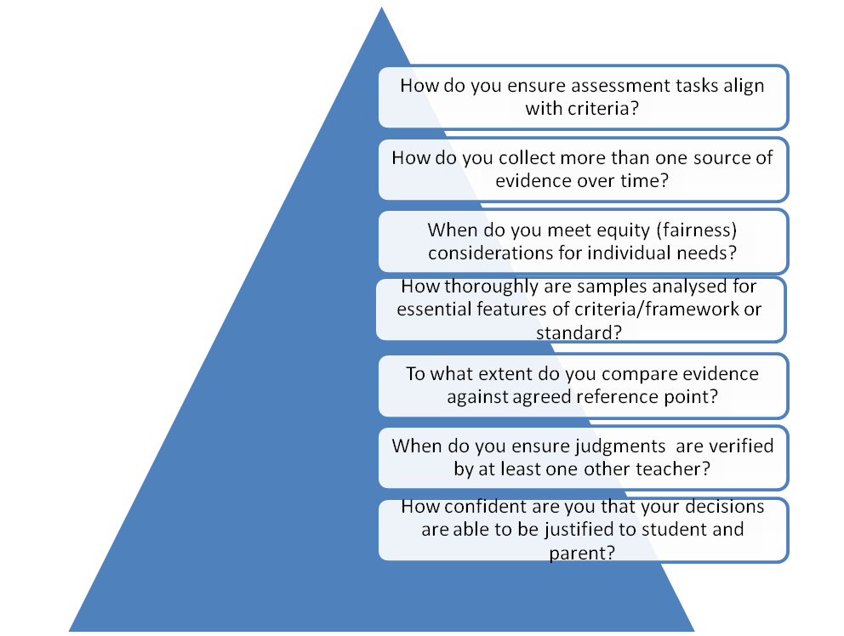
How do you ensure assessments are fair, consistent and defensible?

Slide 4
To what extent do you use moderation processes to deepen teacher knowledge?
Focus on learning and teaching
How do you identify aspects teachers unsure about?
When so you invite experts & facilitators; or engage in further study or research?
How do teachers dialogue to reach deeper understanding?
How do you apply ideas in collaborative planning for learning and teaching?

Slide 5
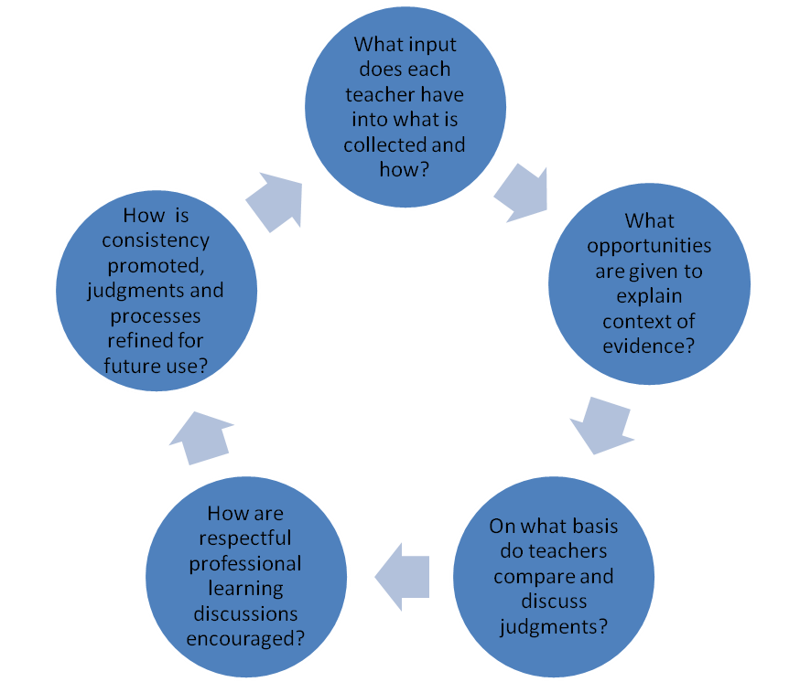
How collaborative are your moderation discussions?

Slide 6
Thinking about influences on OTJs
Discussion Questions:
What impact does belief about learning make to judgments? (underachievement, student motivation or behaviour)
What might influence your perspectives – like names, gender, neatness, length of response?
What difference is made to your judgments when a person more senior or experienced than you offers a different perspective?
How might you benefit from professional discussions and input of new knowledge?
What triggers the need for moderation?

Slide 7
Moderation requires multiple perspectives
“Teachers (insiders) view their students’ work holistically drawing on knowledge and input of the student, his/her capabilities, a range of data and impressions from the learning, teaching and assessment relationship. In contrast, another professional (e.g. Senior Teacher or Principal) may be detached from the teaching/learning experiences with that student, and have a different view on a sample of work. Moderation seeks to reconcile different (insider-outsider) perspectives.” (Radnor, 1993).

Slide 8
To what extent do you value a range of perspectives?
Moderation as a complementary process values the knowledge and perspective of the teacher (insider) and other professionals (outsiders). Together, the insider and outsider combine (subjective) caring and deep knowledge of the student and his/her learning, and (objective) levels or standards of student learning and achievement, to reach a sound and defendable judgment.

Slide 9
Reviewing your processes ( Sample of a self-review process)
What systems are in place? | What do we do now? | What would we like to do? | How can we do this? | By whom and when?
How do we facilitate collaborative planning for learning and assessment?
How do we promote professional dialogue?
How do we deepen teacher knowledge?
How do we collect/analyse student learning?

Slide 10
How consistent are your judgments?
How consistent are your judgments with teachers of students:
in years above or below yours?
across the school?
in other similar or different schools (of similar aged students to ours)
How do you record and monitor your levels of consistency? (so you can see progress)
How consistent are your judgments with an outside person? (e.g. Adviser, facilitator)
How useful might it be to liaise with other schools or relevant facilitators?

Slide 11
Ideas to improve the consistency of OTJs
Team selects one student’s moderation folder that is ‘at’ the standard to take to whole-school moderation. As an extension, repeat the process only bringing the unresolved ones.
Record the independent decisions, both pre- and post-moderation, to track consistency of judgments over time.
Discuss the areas of commonality and differences in OTJ; underlying reasoning, and come to agreed understandings.
Record issues relating to curriculum coverage, student achievement, future improvements to moderation, processes, decisions made about the moderation process.
Consider the use of students’ e-portfolios for moderation.
Discuss how a new teacher to the school is inducted into the moderation process.

Slide 12
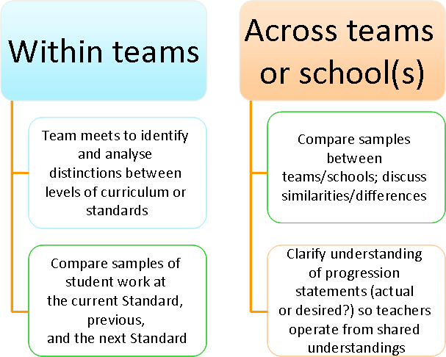
Refining moderation within schools, at transition, and across schools

Slide 13
Consider recording the process in a ‘moderation kit’
A team/school ‘moderation kit’ guides new teachers and
reminds other teachers about agreed procedures. It might
contain:
common understanding of essential learning and assessment
agreed reference point(s) (e.g. NZC, National Curriculum Exemplars Writing Matrix; National Standards)
samples of analysed student work exemplifying the standard at a particular level
guidelines about what type(s) or how many samples are needed for each student
decisions about what needs to be moderated, by whom and when.

Slide 14
Continual improvement of moderation
Refine school processes (refer MOE moderation series and TKI for more information)
Increase participation of students in the moderation process
Work with clusters of schools in or beyond region to further improve moderation

Slide 15
References
Maxwell, G.S. (2002). Moderation of teacher judgements in student assessment. Discussion paper on assessment and reporting. School of Education: The University of Queensland.
Ministry of Education (2010) National Standards Factsheet Overall teacher judgment www.tki.org.nz (retrieved 10 March 2010)
Radnor, H. (1993). Moderation and assessment project. Presentation of a model for moderating pupils’ work that is teacher assessed. Developed in England, UK. Paper presented at Annual Meeting of the American Educational Research Association. (Atlanta).
Wyatt-Smith, C., Klenowski, V., Gunn, S. (2010). The centrality of teachers’ judgement practice in assessment: a study of standards in moderation. Assessment in Education: Principles, Policy & Practice. 17:1, p.59-75.

