Slide 1
Supporting Teachers to make Overall Teacher Judgments
The Consortium for Professional Learning

Slide 2
The Purpose of OTJ workshops
To deepen teacher understanding of the moderation process in the making of dependable overall teacher judgments in reading and writing, with specific reference to the newly developed frameworks and related support materials.

Slide 3
Workshop process
Review the current context in relation to National Standards
Discuss key considerations when moderating
Examine the Frameworks and illustrations – a resource to build greater dependability
The context for this workshop is literacy as we will be examining the Reading and Writing frameworks
Using the frameworks, make evidence-based judgments and engage in professional discussion
Explore principles and requirements for reporting to parents/whānau

Slide 4
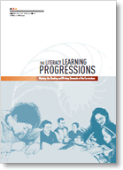
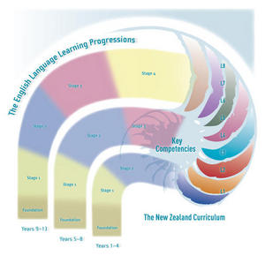
2010
The New Zealand Curriculum
Literacy Learning Progressions & The Number Framework
The National Standards
English Language Learning Progressions

Slide 5
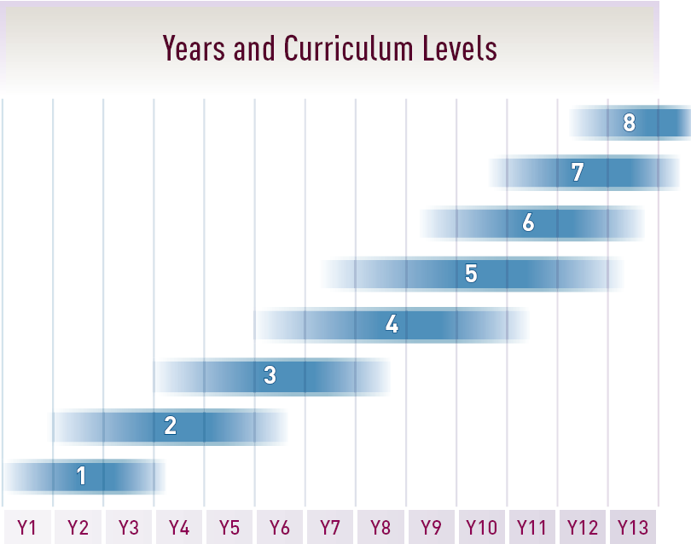
Current context
Curriculum = outcomes
Progression documents = indicators
Standards = signposts for progress in Years 1-8
End of Year 7
End of Year 8
End of Year 5
End of Year 6
After End of
3 years year 4
After 1 year
After 2 years

Slide 6
Making Overall Teacher Judgments
Greater use of agreed reference materials (the NS, LLP, NS illustrations) when making OTJs
Greater range of evidence used to inform OTJs (and less reliance on a one-off test)
Clearer processes for making judgments (school-wide agreed processes) and so more confidence they are providing students/parents/whanau with accurate information
More timely judgments (using current evidence of achievement)
More moderation of judgments (although this is more so in Writing, and perhaps about moderating writing scripts rather than moderation of Writing OTJs)

Slide 7
Moderation
‘Moderation is the process of sharing expectations and understanding of standards in order to improve the consistency of decisions (reaching agreement).’
(TKI Assessment)
What are the informal opportunities that occur?
What are the deliberate moderation opportunities currently happening in your school?

Slide 8
Components of Moderation
1. Shared understanding of the reference materials used to make decisions, including definition of terms.
2. Shared understanding of progressions in the reference materials.
3. Shared understanding of what to notice and recognise when making decisions.
4. Processes to ensure judgments in relation to reference materials are made in a similar way.
Mitchell, K., & Poskitt, J. (2010)

Slide 9
Ready to Read Series
An example where developing a shared understanding is important is the Ready to Read series. Teachers engaged with these texts need to develop a clear understanding about the changes that have taken place, and their place in the National Standards.
Refer to the participant booklet to view some of this information.

Slide 10
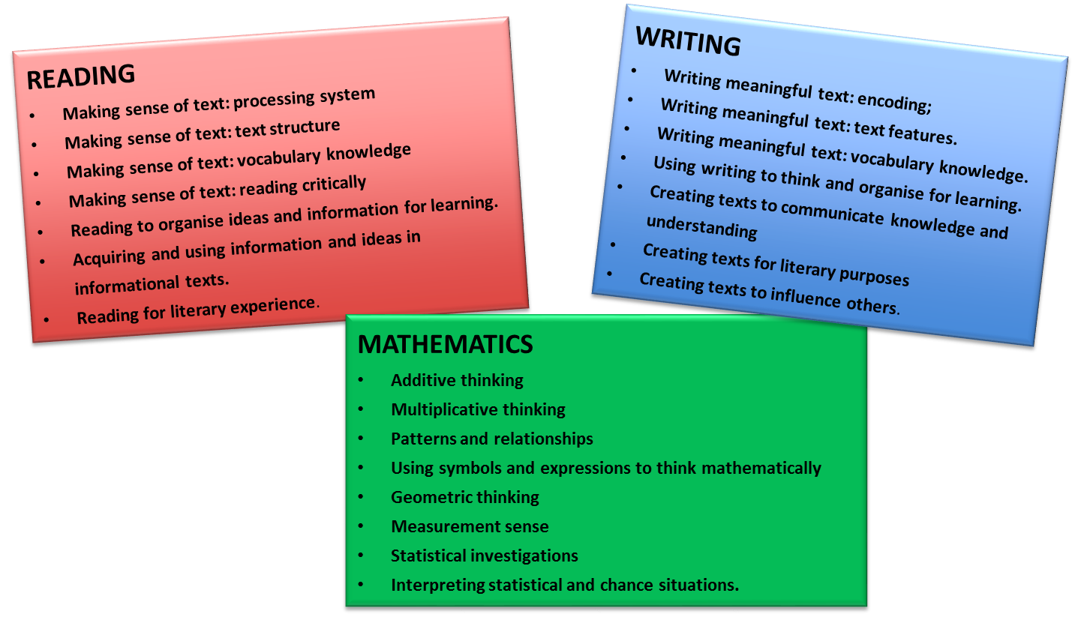
The New Zealand Curriculum
Literacy Learning Progressions & The Number Framework
The National Standards
PaCT Frameworks

Slide 11
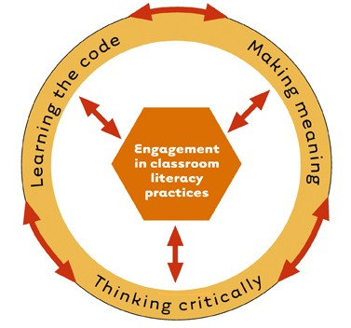
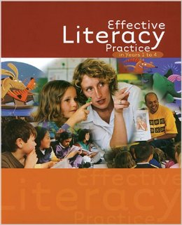
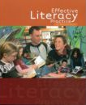
Refining not redefining

Slide 12
PaCT frameworks
Progress and Consistency Tool (PaCT)
READING
Making sense of text: processing system
Making sense of text: text structure
Making sense of text: vocabulary knowledge
Making sense of text: reading critically
Reading to organise ideas and information for learning.
Acquiring and using information and ideas in informational texts.
Reading for literary experience.
WRITING
Writing meaningful text: encoding;
Writing meaningful text: text features.
Writing meaningful text: vocabulary knowledge.
Using writing to think and organise for learning.
Creating texts to communicate knowledge and understanding
Creating texts for literary purposes
Creating texts to influence others.
MATHEMATICS
Additive thinking
Multiplicative thinking
Patterns and relationships
Using symbols and expressions to think mathematically
Geometric thinking
Measurement sense
Statistical investigations
Interpreting statistical and chance situations.

Slide 13
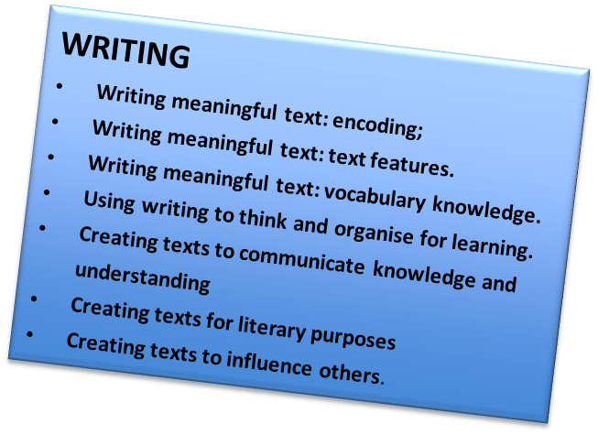
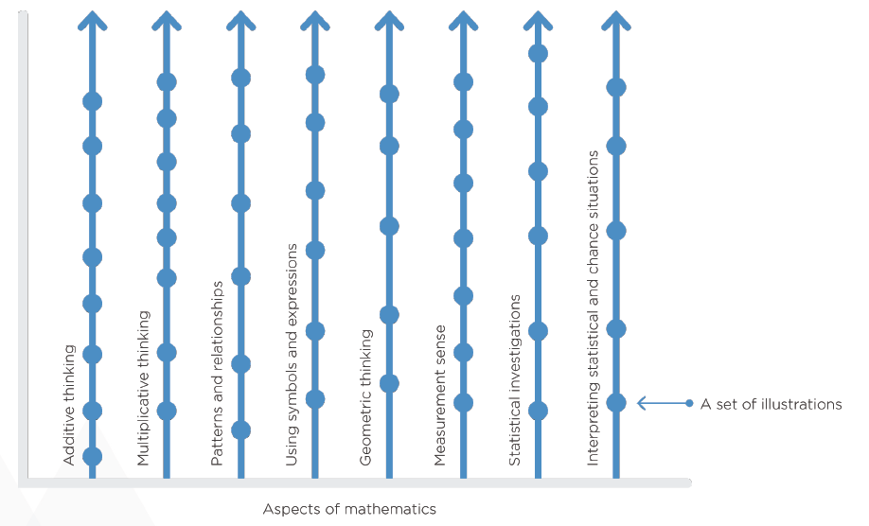
Framework
Using writing to think and organise for learning
Writing meaningful text: using knowledge of text structure & features
Creating texts to communicate knowledge and understanding
Writing meaningful text: Vocabulary
Writing meaningful text: encoding
Creating texts to influence others
Creating texts for literary purposes
A set of illustrations
Aspects of Writing

Slide 14
Sets of Illustrations
The observable steps of learning in each aspect are described through sets of illustrations
Each set has been developed to illustrate big or important ideas in the learning progressions.
Each set describes the important features that teachers should notice and recognise about what each student knows and can do.
A single illustration will not necessarily show everything within a step. The set will provide a more comprehensive picture.

Slide 15
The components of an illustration
A unique title.
The annotation draws attention to the most significant element of the student’s work presented in the illustration.
The problem (for mathematics) or the text and task (reading and writing), which are the focus of the illustration. This includes the conditions under which the task was completed, for example, independently or with support.
The student response details how and what the student did in response to the problem or task. The response may include a work sample and or a transcript of a discussion with a teacher.

Slide 16
Using the Illustrations
The illustrations are NOT assessment tasks to see if students can do them.
They should prompt questions such as:
What evidence do I have?
Is this the type of level that ______ could demonstrate?
Is this the ‘kind of way’ that ______ would solve these problems? (Maths)
Is this the ‘kind of way’ that ______ would write ideas, experiences or information? (Writing)
Is this the ‘kind of way’ ______ would respond to a text (Reading)

Slide 17
Making judgments
Observing (including diagnostic tools such as GloSS, running records)
Listening
Discussing
Conferencing
Questioning
Self assessment
Peer assessment
Student reflections
Explaining
Observations and Conversations
Tasks
Instructional activities
Independent activities
Group activities
Student books
ARBs
Tools
PAT, e-asTTle, STAR, Observation Survey.
Continually Periodically

Slide 18
The Reading and Writing Illustrations
Because reading and writing are cross curricular competencies the illustrations are set in a variety of learning contexts.
The illustrations show the literacy demands of curriculum tasks, not necessarily the expertise in that learning area e.g. Science.

Slide 19
Writing aspect: Using writing to think and organise for learning
Students use their (reading and) writing to organise their ideas and information for different learning purposes. Students develop their ability to use their writing to clarify and develop their ideas as well as reflect on their learning. They develop their expertise in selecting, noting down and organising ideas and information, using appropriate formats. They collate, analyse and classify the content they need for a variety of curriculum tasks.
(This description is in your booklet too!)

Slide 20
Writing Activity One: Identifying writing progression
Writing: Using writing to think and organise for learning
Order these sets of writing illustrations to show the progression through this aspect.
Purpose: to understand the relevant knowledge, skills and behaviours students are exhibiting to complete literacy related curriculum tasks at each progression step.
Note: Carefully consider the annotations and in particular the words in bold, not just the student response.

Slide 21
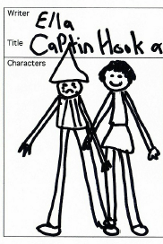
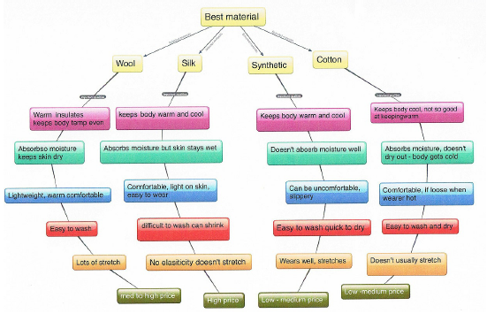
Writing Activity One answers - check first illustration in each set (red star)
Giants
Hook
Tuatara
Tramp
Mindmap

Slide 22
Making aspect judgments
Very few students will perfectly match a set of illustrations with regards to what they can do i.e. there are very few ‘absolutes’.
Students may have strengths in some areas and not others, even within an aspect.
This is the ‘greyness’ which we need to acknowledge and work with.
Teachers need to look at the balance of evidence and place students where they are ‘best described’.

Slide 23
Writing Activity Two - making an aspect judgment
Writing - Using writing to think and organise for learning
Based on the evidence provided, which set of illustrations is the best fit for what these students can do? Work in pairs or small groups.
Choose either:
a junior profile (Kelly)
a senior profile (Matua)

Slide 24
Aspect judgments
Writing - Using writing to think and organise for learning
Kelly – Best described at Set 3 (Tuatara etc.)
Matua – Best described at Set 5 (Mind map etc.)

Slide 25
Reading Making sense of text: Reading critically
This aspect focuses on students’ developing expertise in understanding how writers influence them as readers. They are able to identify the ways in which writers deliberately select language and text features, as well as content, to shape the way they respond to particular ideas or information.
(This description is in your booklet too!)

Slide 26
Reading Activity One: Identifying progression through the annotations
Look at the reading illustrations for
Making sense of text: Reading critically
Purpose: to understand the relevant knowledge, skills and behaviours students are exhibiting to complete literacy related curriculum tasks at each progression step.
Note: Carefully consider the annotations and in particular the words in bold, not just the student response.

Slide 27
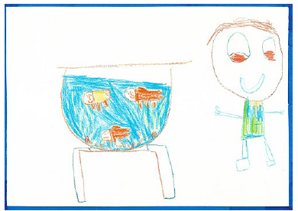
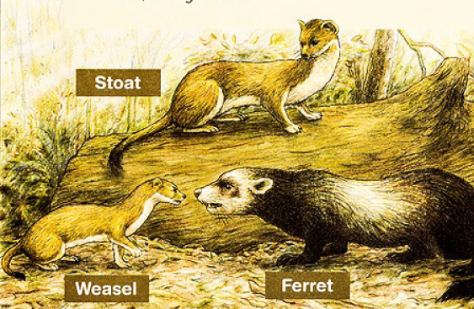
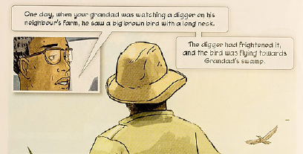
Reading Activity One answers - check first illustration in each set (red star)
1. Aria
2. Joseph
3. Braydon
4. Noah
5. Deer
6. Emperor

Slide 28
Reading Activity Two - making an aspect judgment
Reading: Making sense of text: Reading critically
Based on the evidence provided, which set of illustrations is the best fit for what these students can do? Work in pairs or small groups.
Choose either:
a junior profile (Angela)
a senior profile (Ryan)

Slide 29
Best fit for aspect judgments
Reading: Making sense of text: Reading critically
Angela – Best described at Set 3 (Braydon etc.)
Ryan – Best described at Set 5 (Deer etc.)

Slide 30
Components of moderation
Refer to the components of moderation.
All of the previous activities help support the following components of moderation.
Shared understanding of the reference materials used to make decisions, including definition of terms
Shared understanding of progressions in the reference materials
Shared understanding of what to notice and recognise when making decisions

Slide 31
The value of common frameworks
Builds consistency of what to notice and recognise
Gives a consistent framework within and across schools
Progress through learning steps is made visible
Highlights gaps in learning opportunities

Slide 32
Moderation – systems and processes
Processes to ensure judgments in relation to reference materials are made in a similar way.
Look on Page 33 of your booklet for the resource titled:
Assessment Systems, Practices and Processes
Have a read and take some time to consider this document in relation to your current position.

Slide 33
Role of standardised tools
Standardised tools are a source of evidence that can be used to initiate valuable learning conversations.
Can assist in identifying some of areas of need i.e. where they are at and what they need to work on.
It can provide an external reference into a student’s learning.
It has a function in moderation to support triangulation of evidence.
Standardised test information should remain, but as only one part of a range of evidence to inform an OTJ.
Tests do not provide great insight into the ‘behaviours’ of a student.
Non-correlation does not necessarily mean the OTJ is incorrect.

Slide 34
Reflection time
Consider Handout 1 and the four components of moderation.
In what ways will this workshop impact on moderation practices in your school?
What are your current strengths? (as an individual, as a team, as a school, as a community of schools)
What are your next steps in building dependability?

Slide 35
Reporting to parents and whānau
In this session we will:
Clarify requirements for written reporting to parents.
Explore the principles of effective reporting in its broadest sense.
Support schools to review the quality of their reporting processes.

Slide 36
Using NZC principles when applying NAG 2A
Where a school has students enrolled in years 1–8, the board of trustees, with the principal and teaching staff, is required to, in alignment with requirements set in NAG 1, use Ngā Whanaketanga Rumaki Māori and/or National Standards to:
Report to students and their parents on the student’s progress and achievement in relation to National Standards.
Reporting to parents in plain language in writing must occur at least twice per year.
NZC principles
Overarching principles (Page 9)
Principles of effective assessment (page 40)
Effective pedagogy (page 34)
Principles of effective reporting (TKI Assessment)

Slide 37
Key messages about written reports to parents and whānau
Reference: www.assessment.tki.org.nz/reporting-to-parents

Slide 38
Definitions – What is At, Above, Below, Well below?
For a student to be judged at the standard, evidence of achievement should be, on balance, closest to the standard for their year level or years at school.
For a student to be judged above the standard, evidence of achievement should be, on balance, closest to the standard above their year level or years at school.
For a student to be judged below the standard, evidence of achievement should be, on balance, closest to the standard below their current year level or years at school.
For a student to be judged well below the standard, evidence of achievement should be, on balance, closest to the standard two or more years below their current year level or years at school.
http://assessment.tki.org.nz/Overall-teacher-judgment/Definitions-of-achievement

Slide 39
Reporting to parents without using above, at, below or well below
The board of trustees’ annual report MUST report in relation to National Standards using the four-point scale described in NAG 2a.
For reporting to parents and whānau, schools DO NOT have to use At, Above, Below and Well Below.
http://assessment.tki.org.nz/Reporting-to-parents-whanau/Clarifications-about-National-Standards
However, achievement in relation to the National Standards must be conveyed clearly. Schools can use a number of approaches to achieve this. (e.g. report the year standard which best fits the student’s achievement).
http://assessment.tki.org.nz/Reporting-to-parents-whanau/Examples-and-templates/Reporting-for-students-below-NS

Slide 40
The difference between interim and end of year/anniversary judgments
Interim judgment:
Describes how the student is tracking in relation to their relevant standard.
e.g. the student is on track to meet the standard by the end of the year.
End of year/anniversary judgment:
Describes the student’s progress and achievement in relation to their relevant standard.
e.g. has met, best fit, example from previous slide.

Slide 41
Report content - interim and end of year/anniversary
Interim reports | End of year/anniversary reports
What the student has learnt and can do across the breadth of the curriculum | What the student has learnt and can do across the breadth of the curriculum
Comment on progress | Comment on progress
If students are on track to meet/exceed their relevant standard | If students have met/exceeded their relevant standard
Next steps/aspects that need to be focused on to help the student reach the standard | Next steps/aspects that need to be focused on as they move forward in their learning
If there are more specialised interventions needed because the child is at risk of not meeting the standard by the end of the year | If there are more specialised interventions needed because the child has not met their relevant standard
Ways for parents and whānau to support their child’s learning. | Ways for parents and whānau to support their child’s learning.

Slide 42
English Language Learners
Schools and teachers should use their overall teacher judgment to determine whether reporting to parents using the Progressions or National Standards is more appropriate for individual learners.
Referring to the Ministry National Standards English Language Learners’ guidelines for how long and for whom this alternate reporting option can be used.
Reporting to parents and boards on an English language learners’ progress and achievement in mathematics must be in relation to the national mathematics standards.

Slide 43
After 1/2/3 years at school
The standards for After 1, 2 and 3 years are for the anniversary of the student’s school entry (for example “After one year” at school).
Judgments should be made close to these anniversaries/half year anniversaries but schools can decide when to report this.
However, schools should consider when the information on a student becomes historical and less relevant for parents/whānau.

Slide 44
After 1/2/3 years at school
Reporting to parents could be:
staggered throughout the year around the anniversary date (half anniversary for interim judgments)
at the end of each term
In the form of a ‘postcard’ report for Reading, Writing and Maths, followed by regular reporting in line with standard reporting cycles.
Remember to consult with parents.

Slide 45
Principles of Reporting
Reporting should aim to:
Be reciprocal (ako)
Involve and benefit students
Be clear to parents
Focus on the foundational areas
Include valid information across the breadth of the curriculum
Utilise technologies to enhance information sharing
Enhance student, parent, whānau motivation & engagement

Slide 46
Report Examples
TASK
Using the principles of reporting to critique the report examples in your booklet.
What does this report do well? How?
How could it be improved?
Alternatively, use this time to critique your current reporting practices in relation to the principles of reporting.

Slide 47
Taking today’s learning back into your school
Look at the table in your booklet. Think about any key learnings or things that have made you reflect on how you do things in your school
Use this time to record your thoughts and possible future actions.

Slide 48
Taking today’s learning back into your school
Questions which may help your thinking
Do we have a shared understanding of the reference materials used to make decisions, including definition of terms?
Do we have a shared understanding of progressions in the reference materials?
Do we all know what to notice and recognise when making our decisions?
How confident are we that we have evidence that highlights the key aspects of each standard?
How confident are we that all of our teachers are using a school-wide agreed process to make OTJs?
How user friendly are our systems for recording and using OTJs.
How user friendly are our reporting processes?

Slide 49
Links 1
Moderation
Moderation on TKI - http://assessment.tki.org.nz/Moderation
Illustrations and the National Standards modules - http://nzmaths.co.nz/ns-modules/
Mitchell, K., & Poskitt, J. (2010. How do teachers make overall teacher judgment (OTJs) and how are they supported to make sound and accurate OTJs?) - http://assessment.tki.org.nz/Research-and-readings/National-Standards
Ministry resources
English Language Learning Progressions - http://esolonline.tki.org.nz/ESOL-Online/Student-needs/English-Language-Learning-Progressions
The National Administration Guidelines (NAGs) http://www.education.govt.nz/ministry-of-education/legislation/nags/
Progress and Consistency Tool
Introducing the PaCT and getting started - http://www.pactinfo.education.govt.nz/
Welcome to the Progress and Consistency Tool (PaCT) - http://assessment.tki.org.nz/Progress-and-Consistency-Tool
Reporting to parents and whānau
TKI Reporting to parents and whānau - http://assessment.tki.org.nz/Reporting-to-parents-whānau
English language Leaners guidelines - http://nzcurriculum.tki.org.nz/National-Standards/Key-information/Fact-sheets/English-language-learners
Support material from this workshop will be available on cpl.org.nz.

Slide 50
Links 2
National Standards
Maths poster - http://nzmaths.co.nz/nzc-and-standards
Reading poster -http://nzcurriculum.tki.org.nz/content/download/7801/111265/file/NZC%20Reading%20Standards_Poster_MOE.pdf
Writing poster http://nzcurriculum.tki.org.nz/content/download/7800/111262/file/NZC%20Writing%20Standards_Poster_MOE.pdf
Definitions of student achievement http://assessment.tki.org.nz/Overall-teacher-judgment/Definitions-of-achievement
Clarification about National Standards http://assessment.tki.org.nz/Reporting-to-parents-whanau/Clarifications-about-National-Standards
Support material from this workshop will be available on cpl.org.nz.

